Slide 1
Design Tests——Triang
何启凡
10184304123

Slide 2
Input Space

Slide 3
将边划分成4类
>1
=1
=0
<0

Slide 4
Each Choice
Side1 | Side2 | Side3
2 | 2 | 2
1 | 1 | 1
0 | 0 | 0
-1 | -1 | -1

Slide 5
Pair-Wise
Side1 | Side2 | Side3
2 | 2 | 2
2 | 1 | 1
2 | 0 | 0
2 | -1 | -1
1 | 2 | 1
1 | 1 | 0
1 | 0 | -1
1 | -1 | 2

Slide 6
Pair-Wise
Side1 | Side2 | Side3
0 | 2 | 0
0 | 1 | -1
0 | 0 | 2
0 | -1 | 1
-1 | 2 | -1
-1 | 1 | 2
-1 | 0 | 1
-1 | -1 | 0

Slide 7
Graph

Slide 8
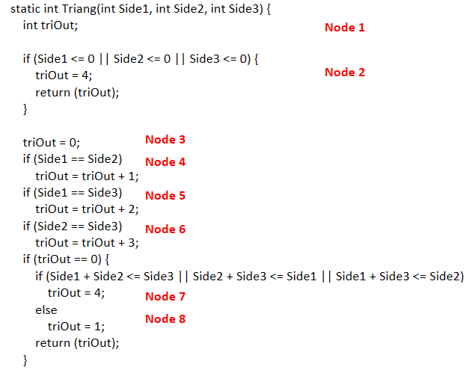
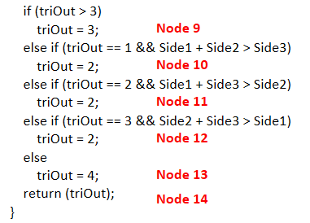
Nodes

Slide 9
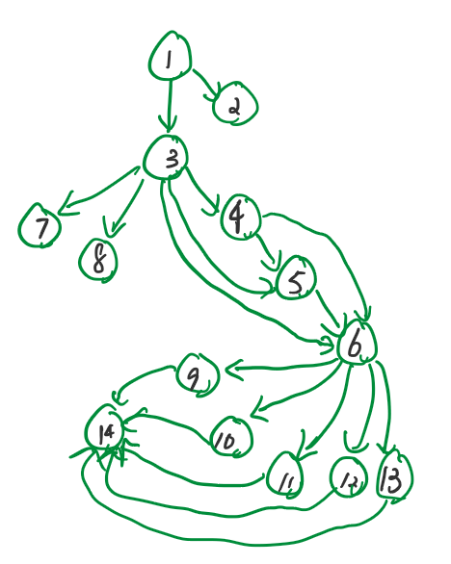

Slide 10
Node
Test Path
[1 2] [1 3 7] [1 3 8]
[1 3 4 5 6 9 14] [1 3 4 10 14] [1 3 5 11 14] [1 3 6 12 14] [1 3 4 13 14]

Slide 11
Node
Side1 | Side2 | Side3
-1 | -1 | -1
1 | 2 | 3
3 | 4 | 5
1 | 1 | 1
2 | 2 | 1
2 | 1 | 2
1 | 2 | 2
1 | 1 | 2

Slide 12
Edge
Test Paths
[1 2] [1 3 7] [1 3 8]
[1 3 4 10 14] [1 3 5 11 14] [1 3 6 12 14]
[1 3 4 13 14] [1 3 5 13 14] [1 3 6 13 14]
[1 3 4 5 6 9 14]

Slide 13
Edge
Side1 | Side2 | Side3
-1 | -1 | -1
1 | 2 | 3
3 | 4 | 5
2 | 2 | 1
2 | 1 | 2
1 | 2 | 2
1 | 1 | 2
1 | 2 | 1
2 | 1 | 1
1 | 1 | 1

Slide 14
Prime Path
[1 2]
[1 3 7] [1 3 8]
[1 3 4 10 14] [1 3 4 13 14] [1 3 5 10 14] [1 3 5 13 14] [1 3 6 12 14] [1 3 6 13 14] [1 3 4 5 6 9 14]

Slide 15
Prime Path
Side1 | Side2 | Side3
-1 | -1 | -1
1 | 2 | 3
3 | 4 | 5
2 | 2 | 1
1 | 1 | 2
2 | 1 | 2
1 | 2 | 1
1 | 2 | 2
2 | 1 | 1
1 | 1 | 1

Slide 16
All-uses
All-uses for triOut
[1 2]
[1 3 7] [1 3 8]
[1 3 4 10 14] [1 3 5 11 14] [1 3 5 13 14] [1 3 6 12 14]
[1 3 4 5 6 9 14]

Slide 17
All-uses
Side1 | Side2 | Side3
-1 | -1 | -1
1 | 2 | 3
3 | 4 | 5
2 | 2 | 1
2 | 1 | 2
1 | 2 | 1
1 | 2 | 2
1 | 1 | 1

Slide 18
Logic

Slide 19
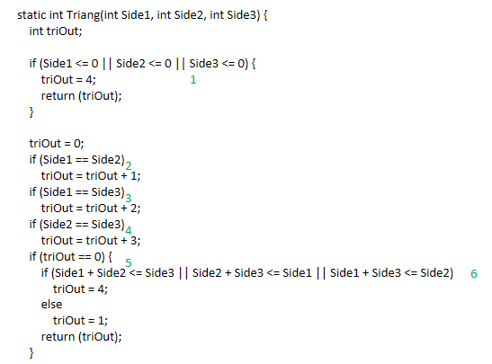
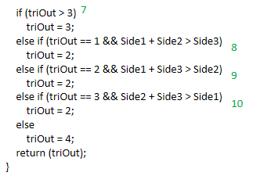
Predicate

Slide 20
Predicate
每个if语句中，表达式结果取到为true或false

Slide 21
Predicate
Side1 | Side2 | Side3
-1 | -1 | -1
2 | 2 | 1
1 | 1 | 1
1 | 2 | 3
3 | 4 | 5
2 | 1 | 2
1 | 2 | 2
1 | 1 | 2
2 | 1 | 1
1 | 2 | 1

Slide 22
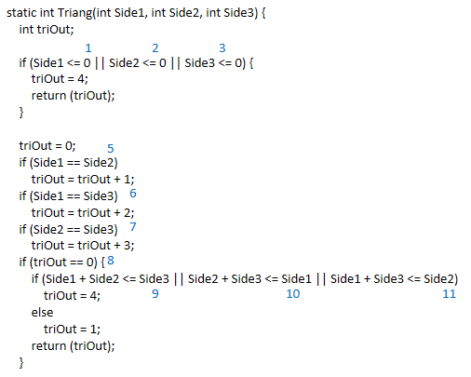
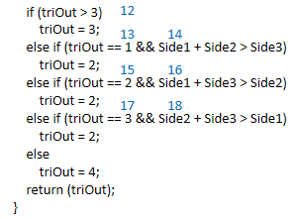
Clause

Slide 23
Clause
每个if语句中，每个二元表达式结果取到true或false

Slide 24
Clause
Side1 | Side2 | Side3
-1 | -1 | -1
1 | 1 | 1
1 | 2 | 3
2 | 1 | 3
3 | 2 | 1
2 | 2 | 1
1 | 1 | 2
2 | 1 | 2
1 | 2 | 1
1 | 2 | 2
2 | 1 | 1

Slide 25
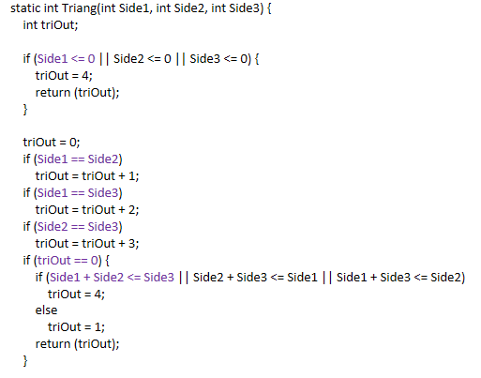
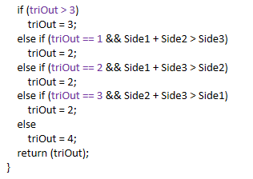
Correlated Active Clause

Slide 26
Correlated Active Clause
选取Major Clause

Slide 27
Correlated Active Clause
Side1 | Side2 | Side3
-1 | 1 | 1
1 | 1 | 1
1 | 2 | 3
3 | 4 | 5
2 | 2 | 1
2 | 1 | 2
1 | 2 | 2
2 | 1 | 1

Slide 28
Syntax

Slide 29
Mutation
对于Mutant - TritypMutantOne.java

Slide 30
Mutation
Side1 | Side2 | Side3
1 | 1 | 2

Slide 31
Mutation
对于Mutant - TritypMutantTwo.java

Slide 32
Mutation
Side1 | Side2 | Side3
1 | 1 | 2

